Slide 1
Compiler Introduction
Weixing Ji

Slide 2
What’s a compiler
A program that accepts as input a program text in a certain language and produces as output a program text in another language, while preserving the meaning of that text (Grune et al, 2000)
Report any error in the source program that it detects during the translation process
A program that reads a program written in one language (source language) and translates it into an equivalent program in another language (target language) (Aho et al)

Slide 3
Language Processors
Compilers
Interpreters
Data
offline
Program
Compiler
Binary
Results
Data
online
Program
Interpreter
Results

Slide 4
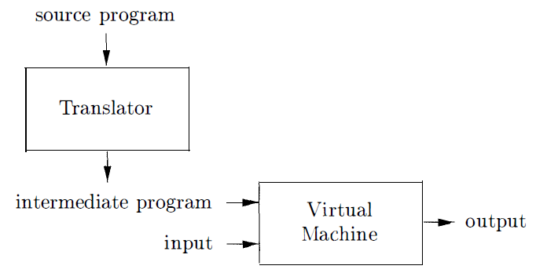
Language Processors
What about Java implementation?
Java language processors combine compilation and interpretation
Compiler
Interpreter

Slide 5
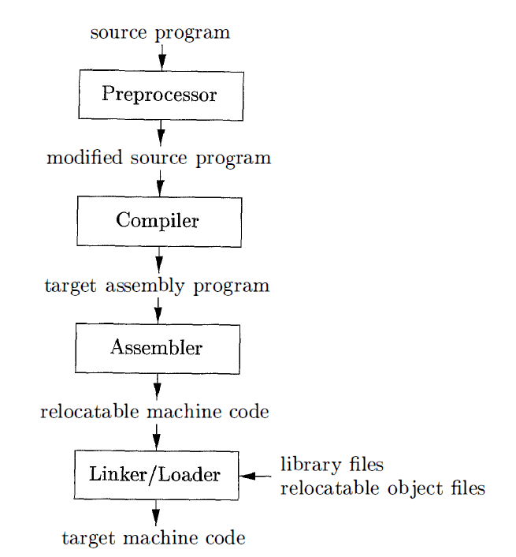
Language Processors
Others

Slide 6
Language Processors
Quick question
What is the difference between a compiler and in interpreter?
A compiler that translates a high-level language into another high-level language is called a source-to-source translator. What advantages are there to using C as a target language for a compiler?

Slide 7
General Structure of a Compiler
The compiler
must generate correct code
must recognise errors
analyses and synthesises
Source code
Compiler
Object code
Errors

Slide 8
Conceptual Structure
Front-end (Analysis) performs the analysis of the source language
Break up the source program into constituent pieces and imposes a grammatical structure on them
Create an intermediate representation
Detect syntactically ill formed or semantically unsound
Collect information about the source code and stores it in a data structure -- symbol table
Source code
Front-End
Intermediate
Representation
Back-End
Target code
Notes:
Recognises legal and illegal programs and reports errors
“understands” the input program and collects its semantics in an IR.
Produces IR and shapes the code for the back-end
Much can be automated

Slide 9
Conceptual Structure
Back-end does the target language synthesis
Chooses instructions to implement each IR operation
Translates IR into target code
Needs to conform with system interfaces
Automation has been less successful
Source code
Front-End
Intermediate
Representation
Back-End
Target code
Notes:
Typically front-end is O(n), while back-end is NP-complete
What is the implication of this separation (front-end: analysis; back-end:synthesis) in building a compiler for, say, a new language?

Slide 10
Conceptual Structure
All language specific knowledge must be encoded in the front-end
All target specific knowledge must be encoded in the back-end
in practice, this strict separation is not free of charge
Fortran
target 1
Front-end
Back-end
Smalltalk
target 2
Front-end
Back-end
I.R.
C
target 3
Front-end
Back-end
Java
target 4
Front-end
Back-end

Slide 11
General Structure of a compiler
Source
Lexical
Analysis
I.C.
Optimisation
tokens
IR
Syntax
Analysis
Code
Generation
Abstract Syntax Tree (AST)
I.R.
symbolic instructions
Semantic
Analysis
Target code
Optimisation
Annotated AST
optimised symbolic instr.
Intermediate
code generat.
Target code
Generation
Target
front-end
back-end

Slide 12
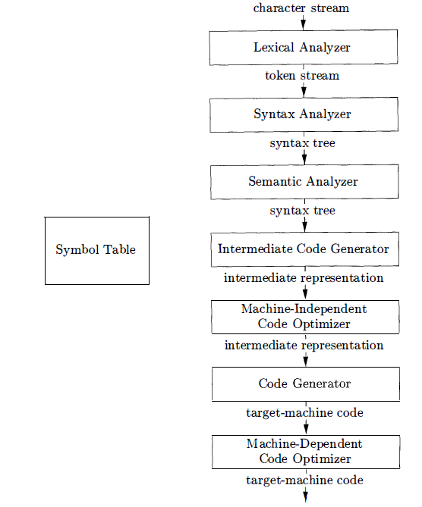
General Structure of a compiler

Slide 13
General Structure of a compiler
Source
Front End
‘Middle End’
Back End
Target
chars
IR
IR
Scan
Optimize
Select Instructions
tokens
IR
Parse
Allocate Registers
AST
IR
Semantics
Emit
IR
IR
Machine Code

Slide 14
General Structure of a compiler ----Lexical Analysis (Scanning)
First step: recognize words
Smallest unit above letters
Lexical analysis divides program text into “words” or “tokens”
This is an example
T hisi s ane xam ple
if x==y then z = 1; else z = 2;

Slide 15
General Structure of a compiler ----Lexical Analysis (Scanning)
Token is a pair of the form
Needs to record each id attribute: keep a symbol table
<type, lexeme>
<token_class, attribute>
<id,a>
<=,>
<id,b>
<+,>
<id,c>
a=b+c
Notes:
Lexical analysis eliminates white space, etc…
Speed is important - use a specialised tool: e.g., flex - a tool for generating scanners: programs which recognise lexical patterns in text; for more info: % man flex

Slide 16
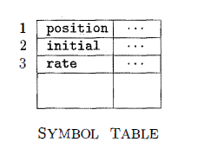
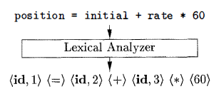
General Structure of a compiler ----Lexical Analysis (Scanning)
Example

Slide 17
General Structure of a compiler ---- Syntax Analysis (Parsing)
Parsing = Diagramming Sentences
The diagram is a tree
This
line
is
a
longer
sentence
article
noun
verb
article
adj.
noun
subject
object
sentence
Notes:
Once words are understood, the next step is to understand sentence structure

Slide 18
General Structure of a compiler ---- Syntax Analysis (Parsing)
Imposes a hierarchical structure on the token stream
Context-free grammars formalize these recursive rules and guide syntax analysis
expression → expression ‘+’ term | expression ‘-’ term | term
term → term ‘*’ factor | term ‘/’ factor | factor
factor → identifier | constant | ‘(‘ expression ‘)’
Notes:
this grammar defines simple algebraic expressions

Slide 19
General Structure of a compiler ---- Syntax Analysis (Parsing)
parse tree for b*b-4*a*c
expression
expression
-
term
term
*
factor
term
*
<id,c>
term
*
factor
term
factor
<id,b>
<id,a>
factor
factor
<id,b>
<const,
4>
Notes:
this grammar defines simple algebraic expressions

Slide 20
General Structure of a compiler ---- Syntax Analysis (Parsing)
An Abstract Syntax Tree (AST) is a more useful data structure for internal representation. It is a compressed version of the parse tree (summary of grammatical structure without details about its derivation)
AST for b*b-4*a*c
-
*
*
<id,b>
<id,b>
*
<id,c>
<const,
4>
<id,a>

Slide 21
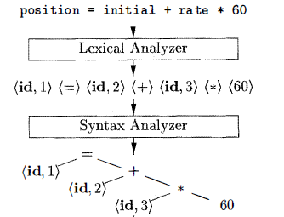
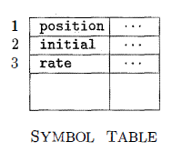
General Structure of a compiler ---- Syntax Analysis (Parsing)
Example

Slide 22
General Structure of a compiler ---- Semantic Analysis
Once sentence structure is understood, we can try to understand “meaning”
This is hard!
Compiler perform limited semantic analysis to catch inconsistence
Example
Jack said Jerry left his assignment at home
Even worse
Jack said Jack left his assignment at home?

Slide 23
General Structure of a compiler ---- Semantic Analysis
Programming languages define strict rules to avoid such ambiguities
{
int Jack = 3;
{
int Jack = 4;
cout << Jack;
}
}
if(state==0)
z = 3;
if(x > 0)
z = 1;
else
z = 0;

Slide 24
General Structure of a compiler ---- Semantic Analysis
Compiler perform many semantic checks besides variable bindings
Example
Jack left her homework at home
A “type mismatch” between her ad Jack; we know they are different people

Slide 25
General Structure of a compiler ---- Semantic Analysis
Collects context (semantic) information, checks for semantic errors, and annotates nodes of the tree with the results
type checking: report error if an operator is applied to an incompatible operand
check flow-of-controls
uniqueness or name-related checks

Slide 26
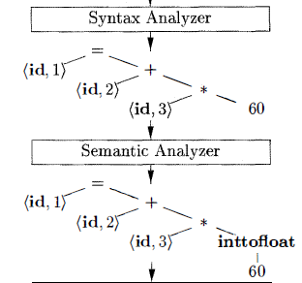
General Structure of a compiler ---- Semantic Analysis
Example

Slide 27
General Structure of a compiler ---- Intermediate code generation
Translate language-specific constructs in the AST into more general constructs.
A criterion for the level of “generality”: it should be straightforward to generate the target code from the intermediate representation chosen.
Example of a form of IR (3-address code):
tmp1=4
tmp2=tmp1*a
tmp3=tmp2*c
tmp4=b*b
tmp5=tmp4-tmp3

Slide 28
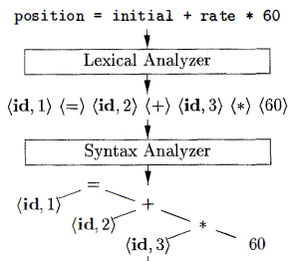
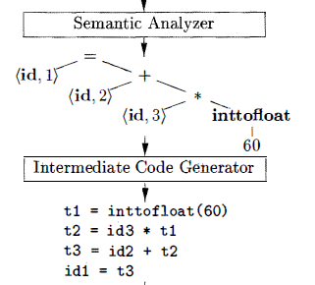
General Structure of a compiler ---- Intermediate code generation
Example

Slide 29
General Structure of a compiler ---- Code Optimisation
The goal is to improve the intermediate code and, thus, the effectiveness of code generation and the performance of the target code.
Optimizations can range from trivial (e.g. constant folding) to highly sophisticated (e.g, in-lining)
Source
code
Front-End
IR
Middle-End
(optimiser)
IR
Back-End
Target
code

Slide 30
General Structure of a compiler ---- Code Optimisation
Optimization has no strong counterpart in English
But a little bit like editing
Automatically modify programs so that they
Run faster
Use less memory
Consume less energy
Example
X = Y * 0 is the same as X = 0 Integer

Slide 31
General Structure of a compiler ---- Code Generation Phase
Map the AST onto a linear list of target machine instructions in a symbolic form
Instruction selection: a pattern matching problem
Register allocation
Instruction scheduling
machine-specific optimization
Machine code generation

Slide 32
General Structure of a compiler ---- Some historical notes
1945-1960: code generation
need to “prove” that high-level programming can produce efficient code (“automatic programming”).
1960-1975: parsing
proliferation of programming languages
study of formal languages reveals powerful techniques.
1975-: code generation and code optimization
Knuth (1962) observed that “in this field there has been an unusual amount of parallel discovery of the same technique by people working independently”

Slide 33
General Structure of a compiler
The overall structure of almost every compiler adheres to our outline
Parts of a compiler can be generated automatically using generators based on formalisms
Scanner generators: flex
Parser generators: bison

